Slide 1

OBJECTIVES FOR THIS SESSION
COURSE OVERVIEW
Why do we teach this course ?
What will you learn on this course ?
LEARNING TO LEARN
What are the good habits to learn effectively ?

Slide 2


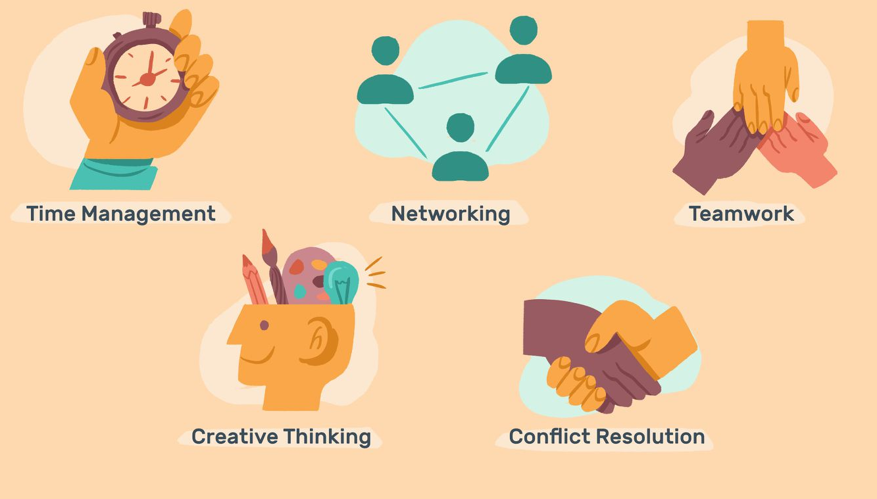
DISCUSSION
Are those skills important ? Why ?
10 MIN
1
DISCUSS
2
SHARE
TO COMPLETE THIS ACTIVITY :
Find 2 reasons for each skills
Write each reason on posts it
Put your POST IT on white board

Slide 3


EXPLAIN
THIS COURSE WILL ALLOW YOU TO
Learn
Effectively
Work
Effectively
AT SCHOOL
AT COMPAGNY

Slide 4
EXPLAIN
COURSE OBJECTIVES, TERM BY TERM….
Public speaking skills
Presentation skills
Non verbal communication
HOW TO COMMUNICATE
Good Study Habits
Communicate to learn
Mechanism of the brain
Note taking skills
Critical reading
Searching skills
Problem solving
HOW TO LEARN & THINK
TERM 1

Slide 5
EXPLAIN
COURSE OBJECTIVES, TERM BY TERM….
Tasks planning
Tasks follow up
Leadership
Conflict management
Money Literacy
HOW TO DO A REAL PROJECT
Public speaking skills
Presentation skills
Non verbal communication
HOW TO COMMUNICATE
Good Study Habits
Communicate to learn
Mechanism of the brain
Note taking skills
Critical reading
Searching skills
Problem solving
TERM 2
HOW TO LEARN & THINK
TERM 1

Slide 6
EXPLAIN
COURSE OBJECTIVES, TERM BY TERM….
Career exploration
Career building
HOW TO EXPLORE & BUILD A CARRER
Tasks planning
Tasks follow up
Leadership
Conflict management
Money Literacy
HOW TO DO A REAL PROJECT
TERM 3
Public speaking skills
Presentation skills
Non verbal communication
HOW TO COMMUNICATE
Good Study Habits
Communicate to learn
Mechanism of the brain
Note taking skills
Critical reading
Searching skills
Problem solving
TERM 2
HOW TO LEARN & THINK
TERM 1

Slide 7
EXPLAIN
COURSE OBJECTIVES, TERM BY TERM….
HOW TO START UP AN IT BUSINESS
Professional environment
Entrepreneurship
Career exploration
Career building
HOW TO EXPLORE & BUILD A CARRER
Tasks planning
Tasks follow up
Leadership
Conflict management
Money Literacy
TERM 4
HOW TO DO A REAL PROJECT
TERM 3
Public speaking skills
Presentation skills
Non verbal communication
HOW TO COMMUNICATE
Good Study Habits
Communicate to learn
Mechanism of the brain
Note taking skills
Critical reading
Searching skills
Problem solving
TERM 2
HOW TO LEARN & THINK
TERM 1

Slide 8
2 PROJECTS TO PERFORM
NOTE TAKING PROJECT
HOW TO COMMUNICATE
Good Study Habits
Communicate to learn
Mechanism of the brain
Note taking skills
Critical reading
Searching skills
Problem solving
Public speaking skills
Presentation skills
Non verbal communication
HOW TO LEARN & THINK
PERSONAL SKILL PROJECT
HOW TO COMMUNICATE
Good Study Habits
Communicate to learn
Mechanism of the brain
Note taking skills
Critical reading
Searching skills
Problem solving
Public speaking skills
Presentation skills
Non verbal communication
HOW TO LEARN & THINK

Slide 9


EXPLAIN
NOTE TAKING PROJECT
PROJECT 1
Paper Notes
PROJECT 2
Computer Notes
How to take notes
JAN
FEV
MAR
APR
MAY
BCU COURSE
BCU COURSE

Slide 10

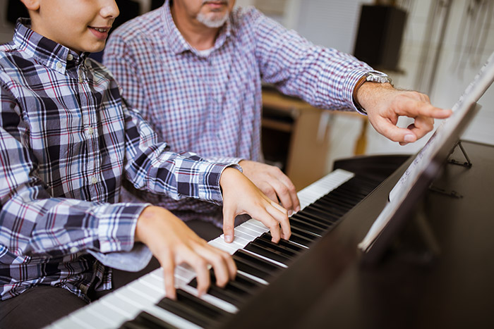
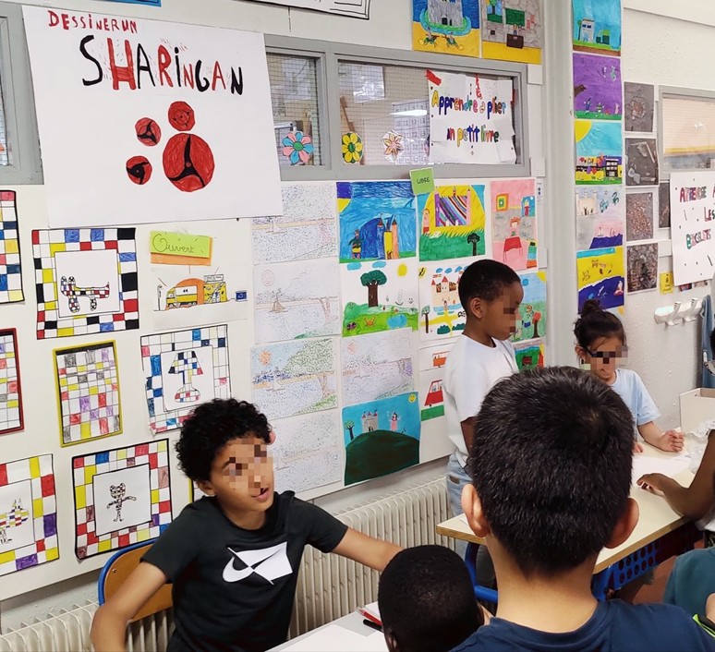
EXPLAIN
PERSONAL SKILL PROJECTS
Identify a skill to learn
Learn a skill
Present your skills
JAN
FEV
MAR
APR
MAY
SKILL FORUM

Slide 11
EXPLAIN
COURSE EVALUATION
TERM 1

Slide 12
CHAPTER 1 : LEARN TO LEARN
Good study routines

Slide 13
ACTIVITY 1
What should be your good study habits ?
20 MIN
BEFORE CLASS
DURING CLASS
AFTER CLASS
1
MAKE TEAMS !!
2
DISCUSS IN TEAM !! 10 min
3
PRESENT TO THE CLASS !! 10 min
TO COMPLETE THIS ACTIVITY :
3 students per team
Each work on a specific time
(before /during / after)
Write ideas on POST IT
Put your POST IT on white board

Slide 14
EXPLAIN
What should be your good study habits ?
10 MIN
BEFORE CLASS
DURING CLASS
AFTER CLASS
I prepare questions
I review the lesson
I prepare study material
I know the time, room
I leave my bag on the floor
I sit in a proper way
I review my notes
I review my lesson
I do my homework
I summarize the important points
I’m an active listener
I show active participation
I ask for clarification if I don’t understand
I listen with attention without disturbing the speaker
I take note of all important concepts.
I list my assignments in my personal schedule.

Slide 15


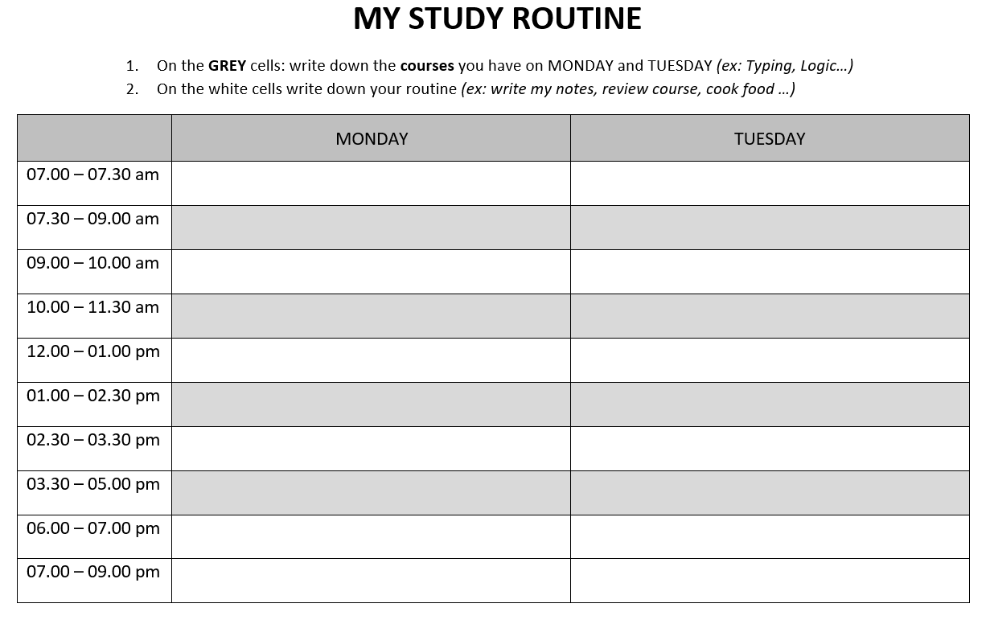
HOMEWORK
HOMEWORK
Look at the schedule of this week
Complete this schedule with your study habits
Compare your schedule with other classmates
Warning : be realistic !

Slide 16
DISCUSS
10 MIN
What did we learn ?
1
Draw on flip chart a mind map representing the key words of this lesson and their relationship
DRAW
2
Present your flip char to another group
SHARE

